Slide 1

Order Processing System
Team Radiant

Slide 2

tBharat Gupta
Team Radiant
Ayushi Aggarwal
Bharat Gupta
Om Ashish Mishra
Siddhant Pandey
Riya Puri
Tarun Angrish

Slide 3
v
Introduction
The project involved us in designing and developing a Order Processing System, with a certain group of functionalities and certain end cases.
The team designed and developed the web application which was capable of performing the necessary functionalities, along with a reliable and extensible database.
Considering HSBC’s core values into the back of our minds, we tried to inculcate them accordingly and thus designed the app as ‘loosely-coupled’ as possible.
The training that we underwent proved to be immensely helpful in this project and aided us with all the tools and technology concepts that can be applied in to solving real-world problems.
Dependable, open, connected and flexible

Slide 4
v
Approach to Problem Solving
In these unprecedented times, the team collaborated virtually and everyone did their part. Though there were certain disadvantages to collaborating online, but by the end of the project, all were somewhere well versed with the right set of approach to tackling problems.
The team was allotted tasks accordingly to their SWOT analysis and each module was quantified and tracked according to the project progress.
High level system design, database design and frontend mockups were done initially so that team could discuss and vet accordingly to what is required.
Each task when done was communicated to the entire team effectively and no communication gap was experienced.
Many new problem solving techniques, design patterns, technologies and tools were learnt in this process.

Slide 5

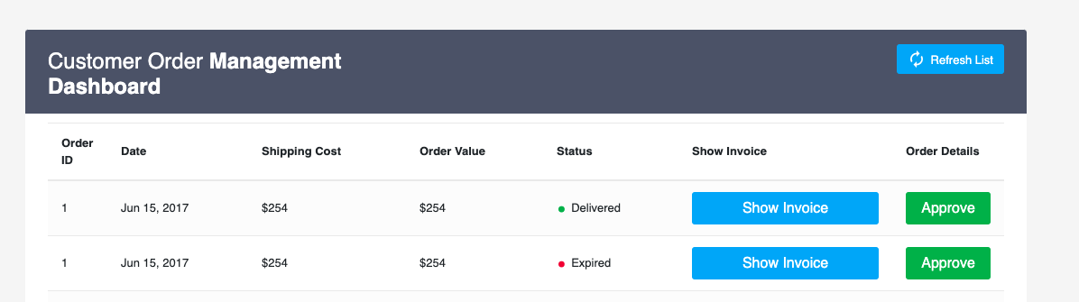
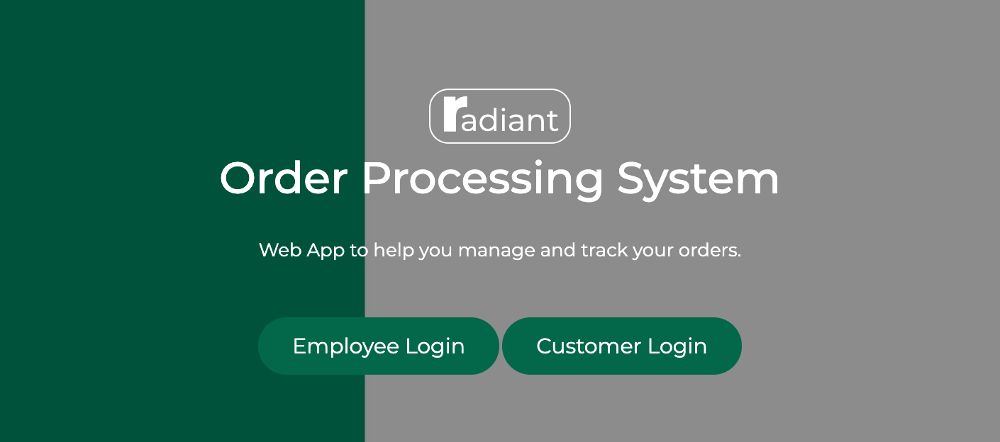
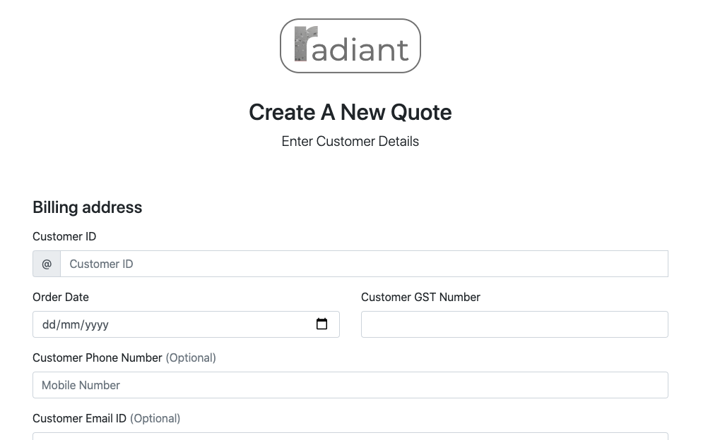
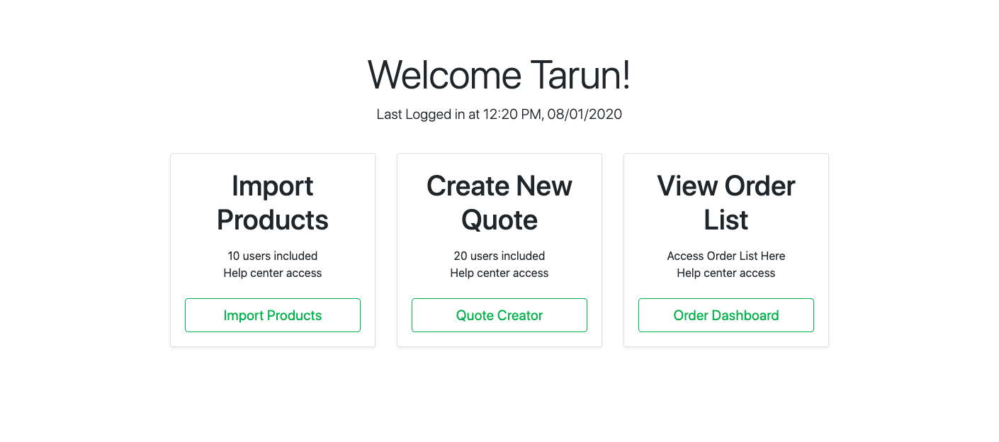
v
Product Screens

Slide 6
Thank You!

